Slide 1






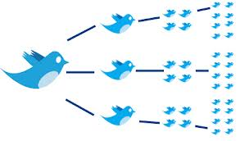


TEXT ANALYTICS Fall 2019 Session 1, 10/21, 10/22
Dr. Anitesh Barua
David Bruton Jr. Centennial Chair Professor of Business
Distinguished Fellow, INFORMS Information Systems Society
Stevens Piper Foundation Professor
University of Texas Distinguished Teaching Professor
Associate Director, Center for Research in e-Commerce
McCombs School of Business, University of Texas at Austin
Email: aniteshb@gmail.com

Slide 2
A Serious Analytics Course, But What is the Connection to Business?
Which brands do people compare with entry level Mercedes cars?
How can we predict which brands and models customers will switch from to, say, a Tesla?
How can we recommend products that meet specific customer requirements?
How can we predict the sales of a new product that is yet to be released?
How does Netflix figure out what will be a hit series?
How does Airbnb predict which images and descriptions get a property rented faster?
How can we discover new side effects of a prescription drug?
Yes, it connects to business, ……
Copyright Anitesh Barua 2019

Slide 3
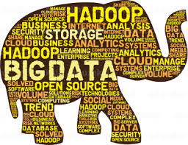
Text Analytics: A Subset of User Generated Content Analytics
User Generated Content (UGC) = unstructured data (text, images, audio, video), structured data is numeric
Two sources of UGC
External: Social media
Internal: Company documents (e.g., shareholder reports, HR evaluations, contracts, vendor reports, customer conversations, maintenance reports, etc.), medical reports, etc.
Copyright Anitesh Barua 2019

Slide 4
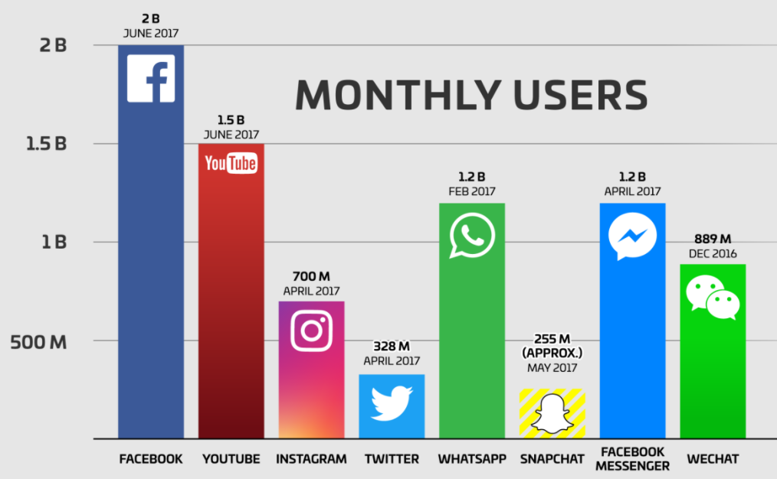
Why Bother About Text?
> 80% of all data are unstructured user generated content
Web pages, online conversations/posts, digital libraries, etc.
Twitter: 600 million daily tweets
FB: 5+ billion pieces of content shared daily
Conversations in online forums

Slide 5
Traditional Applications of Text Mining
Classification of content: e.g., news, reviews, blogs, web pages
Clustering “similar” documents
Information retrieval

Slide 6

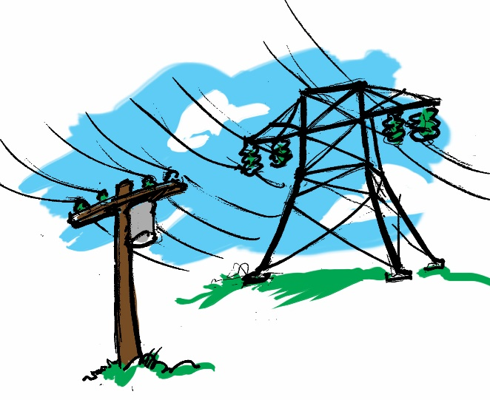
Business Applications With Unstructured Big Data
Healthcare
Which CHF patients will be readmitted?
Free-form inputs (text) about lifestyle most important predictor
Electric grid failures
Traditional models
Enriching with text
Copyright Anitesh Barua, 2019

Slide 7

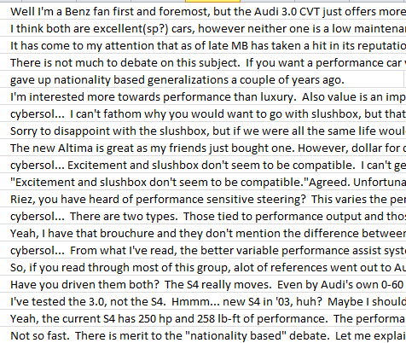
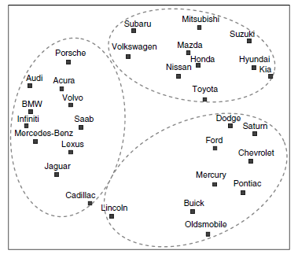
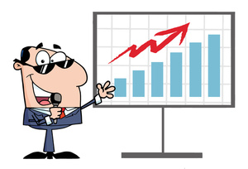



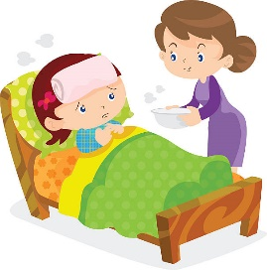
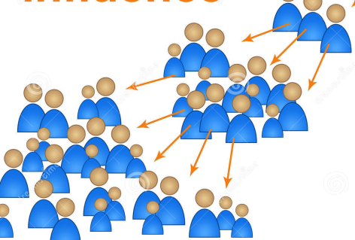
The Untapped Potential of User Generated Content
Obtain insights: Analyze brand & product associations, predict switching
Build crowdsourced
recommendation
systems
Predict:
E.g., salesrank,
retention, spend,
etc.
Metrics, metrics & more metrics
Create new
products/services
Who matter most:
Find influencers
Copyright Anitesh Barua 2019

Slide 8
Before and After this Course
Do you know how to | Yes/No
Extract tweets with detailed user info including location & other attributes?
Extract conversations in online forums, blogs, Youtube, etc.?
Analyze unstructured data to generate new business insights and discover facts?
Leverage the wisdom of the crowd to create new products/services?
Analyze consumer sentiments using supervised and unsupervised methods?
Predict business outcomes (e.g., sales) from social data
Assess resonance between a message (e.g., a campaign) & response?
Leverage the power of images in making business predictions?
Copyright Anitesh Barua 2019

Slide 9

Tools, Techniques, ….
Python scripts (or R, if you prefer, but no help from TA)
Write your own scripts
No coding taught in class (but TA will help)
Scrapers & data access tools
Custom scripts for social media metrics & analyses
Sentiment analyzer
Copyright Anitesh Barua 2019

Slide 10
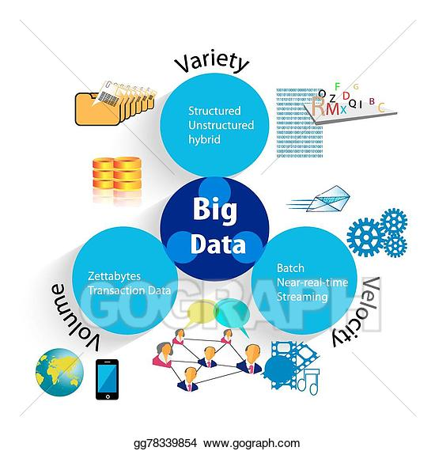
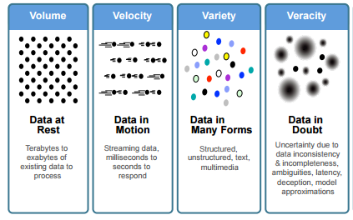
UGC and Four Vs of Big Data
What has UGC got to do with the Vs of big data?
Source: IBM

Slide 11

“Told You, it’s all Fake!”
When machine learning generates (fake) reviews
Easily my favorite Italian restaurant. I love the taster menu, everything is amazing on it. I suggest the carpaccio and the asparagus. Sadly it has become more widely known and becoming difficult to get a reservation for prime times.
My family and I are huge fans of this place. The staff is super nice and the food is great. The chicken is very good and the garlic sauce is perfect. Ice cream topped with fruit is delicious too. Highly recommended!
I come here every year during Christmas and I absolutely love the pasta! Well worth the price!
Excellent pizza, lasagna and some of the best scallops I've had. The dessert was also extensive and fantastic.
The food here is freaking amazing, the portions are giant. The cheese bagel was cooked to perfection and well prepared, fresh & delicious! The service was fast. Our favorite spot for sure! We will be back!
I have been a customer for about a year and a half and I have nothing but great things to say about this place. I always get the pizza, but the Italian beef was also good and I was impressed. The service was outstanding. The best service I have ever had. Highly recommended.
1, 3 & 4 are real, 2, 5 and 6 are fake

Slide 12

But Machine Learning & Artificial Intelligence can Far Exceed Human Performance
Harley Davidson dealership in NYC selling 1-2 per week
Chance encounter with CEO of an AI company
AI driven marketing platform
Measures, optimizes campaigns across digital channels
Sold 15 in first weekend of deployment
From 1 lead/day → 40, new call center set up
15% “lookalikes”
Month 3: Leads ↑ 2930%, 50% lookalikes
Redefining “potential customers”
How does the AI based program do it?
Source: HBSP

Slide 13
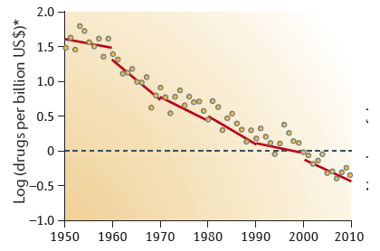
Text Analytics in Pharma: Help Overturn Eroom’s Law?
Biosciences: 10,000 new publications uploaded on a daily basis
Must correlate, assimilate and connect massive amounts of data
Make connections between data and generate hypotheses using criteria set by the scientist
E.g., 200 hypotheses for Amyotrophic Lateral Sclerosis by BenevolentAI

Slide 14
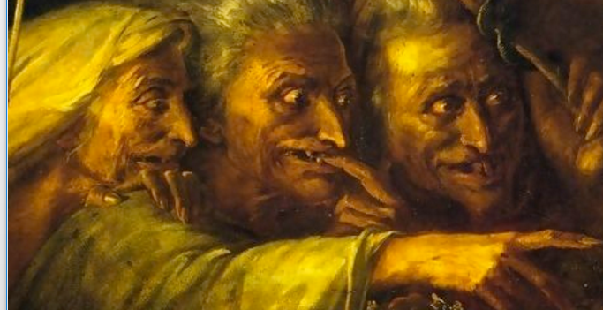
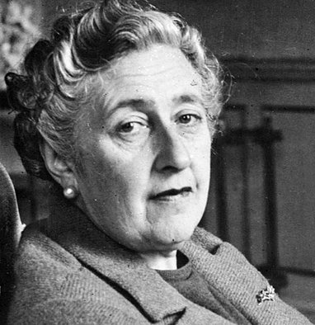
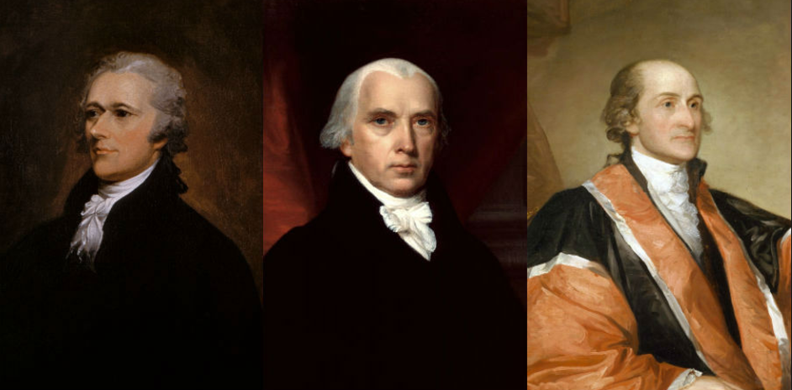
Innovative Applications Outside of Business Domain
Literature
Who wrote Macbeth?
When did Agatha Christie develop Alzheimer’s?
History
Who wrote the Federalist papers?
https://www.lexalytics.com/lexablog/2015/who-wrote-macbeth-3-things-text-mining-can-tell-us-about-authors

Slide 15

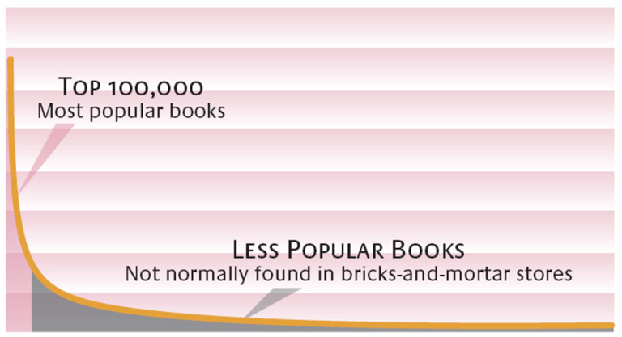
The Connection to Business: The Long Tail*
Effect of the Internet
Sales
High Popularity Low
Customer preferences are diverse
What is the role of recommender systems and word-of-mouth?
Copyright Anitesh Barua, 2018
Source: Brynjolfsson, Hu and Smith; *Chris Anderson

Slide 16
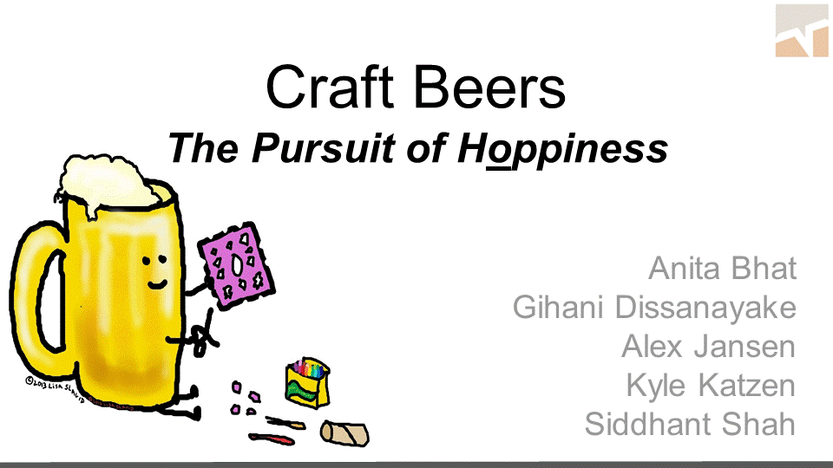
*Students in UT Austin’s MSBA program

Slide 17
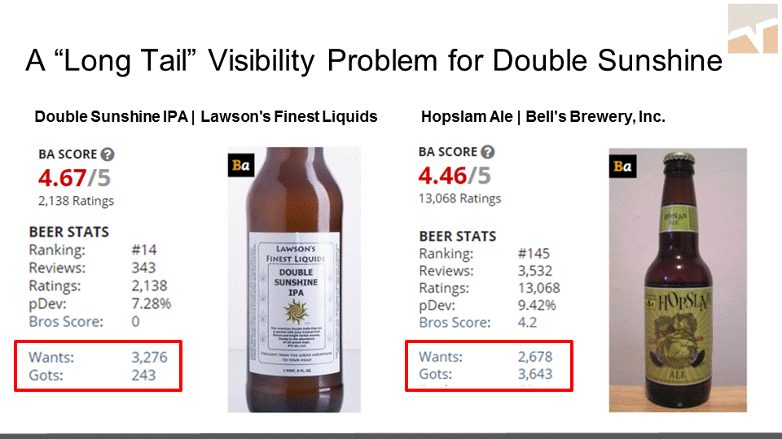

Slide 18
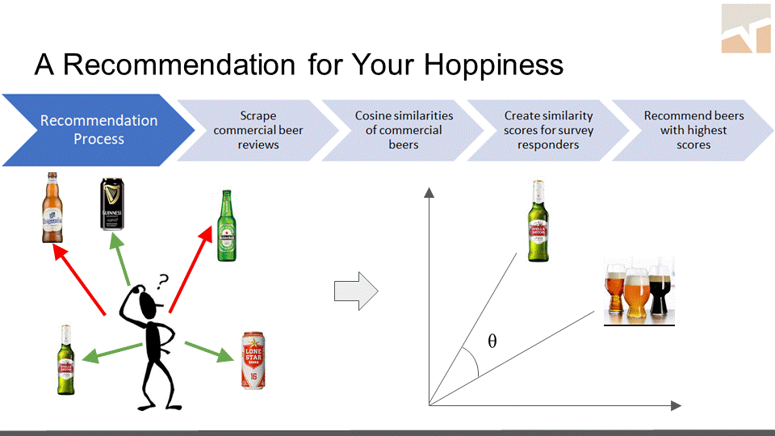

Slide 19

When Numeric Data Don’t Explain Differences in Preferences
Similar demographics, but very different preferences in music
Yet, unstructured data (e.g., blogs) can predict much more accurately
Computer Science, 26
likes country music
27
es pop
Engineer, 26,
likes prog
rock
Engineer, 27
likes R&B
Economics, 25,
likes R&B
Engineer, 27
likes jazz
Copyright Anitesh Barua 2019

Slide 20
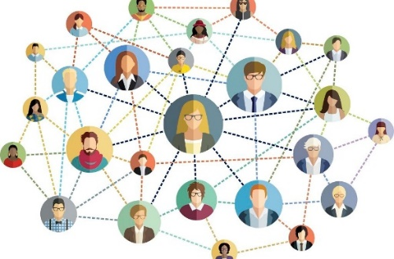
Pros & Cons of Online Social Data
Pros (relative to a survey) | Cons | Mitigation?
Copyright Anitesh Barua 2019

